Slide 1
Tally Introduction
Presented by S.R.Zameer

Slide 2
Getting start with tally erp9
Start up

Slide 3
Startup
For learn Tally.ERP9 you need a computer and Tally.ERP9 software of course. If you don't have original version, you can download Tally.ERP9 Educational Version from www.tallysolutions.com There are some limitations in the Education Version such as vouchers can be entered only first, second or last date of the month and some reports are also not viewable.
After download the file, make complete setup in your computer.
For opening your Tally press on Start>All Program>Tally.ERP9>Tally.ERP9.exe or simply you can click onTally.ERP9 Icon from Desktop. Firstly you will see Startup Window as given below. Select Single User or Multi-User Mode to work in educational mode.

Slide 4
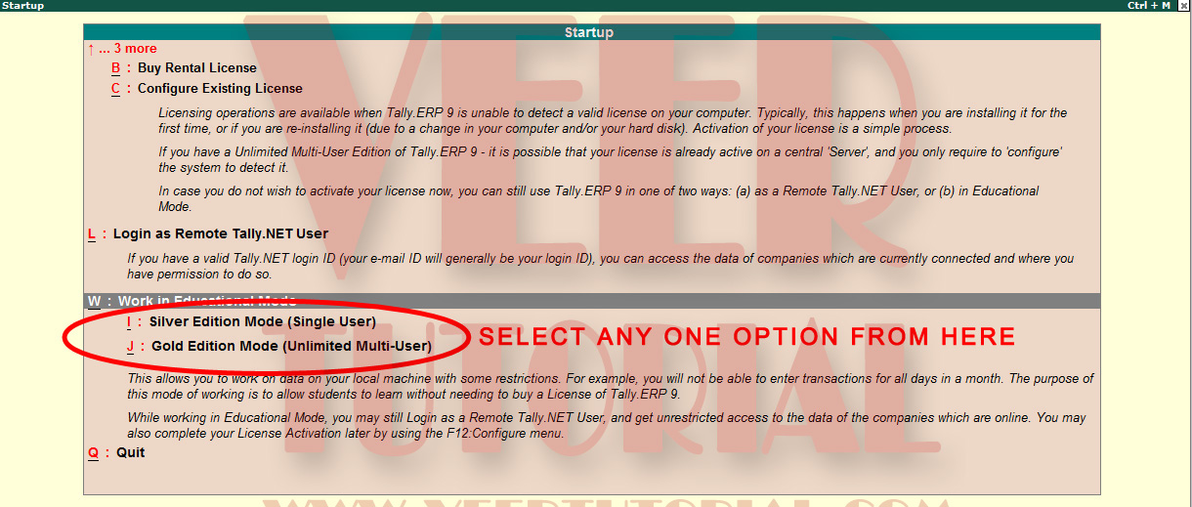
Startup

Slide 5
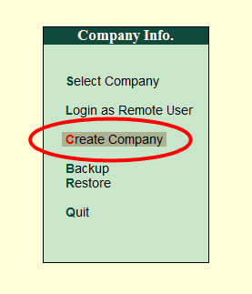
Create New Company
For Creating a New Company Go To Company Info.>Create Company and press enter

Slide 6
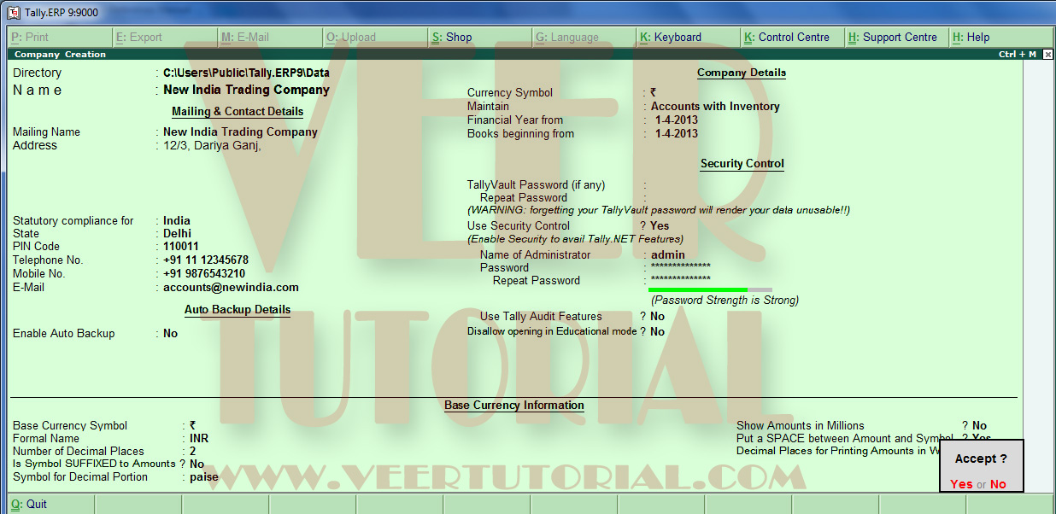
Company Creation Window will be appear as shown below:

Slide 7
Explanation
Directory Enter the path of the directory where you want to save company's data. If you want to change the directoy Press backspace button, type the new path.
Name Enter the name of the company you want to create.
Mailing Name Enter the mailing name of the company. It can be different from the above field. Please note that only Mailing Name will appear on the reports/invoices
Address Enter the address of the company.
Statutory Compliances for Select the Country from the right hand side list
State Select the State from the right hand side list. Please note that VAT will be applicable only for the selected state.

Slide 8
Contd….
Pin Code Enter Pin Code
Telephone No Enter Telephone Number
Mobile No Enter Mobile Number
Email Enter Email
Enable Auto backup Select Yes if you want to make automated backup of your data. You will learn in detail on this in later chapter
Currency Symbol Select Currency symbol. It will come automatically according to your country selection
Maintain Accounts only Accounts with Inventory only Select this option if you don't want to maintain Inventory Select this option if you want to maintain Inventory
Financial Year From Enter the begining/first date of financial year, you wish to start accounts

Slide 9
Contd….
Books begining from This date may be differ from above because your business may be start middle of year or any date. Therefore, enter the date you want to start books of accounts but you can't enter any voucher before this date. For example, company established on 01/05/2012 and start doing business on 01/06/2012. The financial year will be 2012 and financial year start date will be 01/04/2012 and accounts books will be begin from 01/06/2012.
Tally Vault Password Tally Vault is an advanced security system. It can encrypt normal Tally's company data and covert into non-recognized data. Enter the password and repeat the same. You can access this company only if you have this password. It is important, you don't forgot the password. There is no other way to recover the data without password

Slide 10
Contd…
Use Security Control Yes, always use this security control feature but if you don't want anyone can access your company's data/information.
Name of Administrator Enter the Administrator Name
Password & Repeat Password Enter the Password & repeat the same. You can see a green & red line below of password. It indicates the security level of password. Use albhabatic-numeric with special symbol in the password.
Use Tally Audit Feature Use this feature if you want to do track the record of any changes in the financial report. Only administrator or auditor profile can use this feature.
Disallow opening in Educational Mode Use this option 'Yes' if you dont want to open your company's data in the Educational Version of Tally.ERP9, otherwise use 'No‘

Slide 11
Contd…
Base Currency Symbol Tally has multi currency feature. Enter base currency according to your Country such as Indian Rupees is the base currency for India. Tally will get base currency by default according to selected country.
Name of Administrator Enter the Administrator Name
Formal Name Change the formal name of the currency if you want
Is symbol SUFFIX to the amounts Select 'YES" if you want to put Currency Symbol before the amount in the Tally Reports, other select 'NO‘
Symbol for decimal portion Enter the Name of Decimal portion of the base currency, such as paisa for Indian Rupees
Name of Administrator Enter the Administrator Name

Slide 12
Contd….
Show amounts in millions Select 'YES' if you want to show the amount in million, billions instead of Lakh, Crore otherwise select 'NO‘
Put space between amount and symbol Select 'YES' if you want to put space between amount and symbol in the Tally Reports
Decimal places for printing amount in words Enter the number for decimal places, for example if you put 3 then in the reports such as invoice, amount in words would be upto 3 decimal places.
After enter the above details, accept the screen 'yes' for save and 'No' if you want to make some changes. After make changes save the screen.
Now you have created your company.

Slide 13
How to Open A Company
For Open any company Go To Company Info>Select Company Press Enter
Select the Company from the list. If company is not available, check the path of data from Path field. Change path if data is in different location
If you have already opened any company and want to open another company, Press F1 or Click on the Top Right F1:Select Cmp Button.

Slide 14
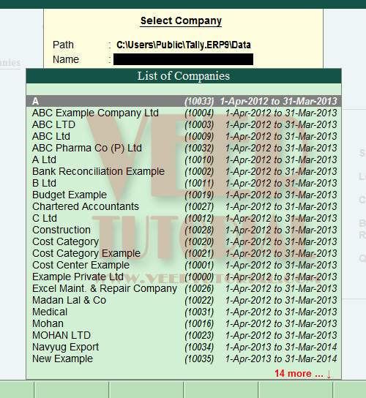
Contd….

Slide 15
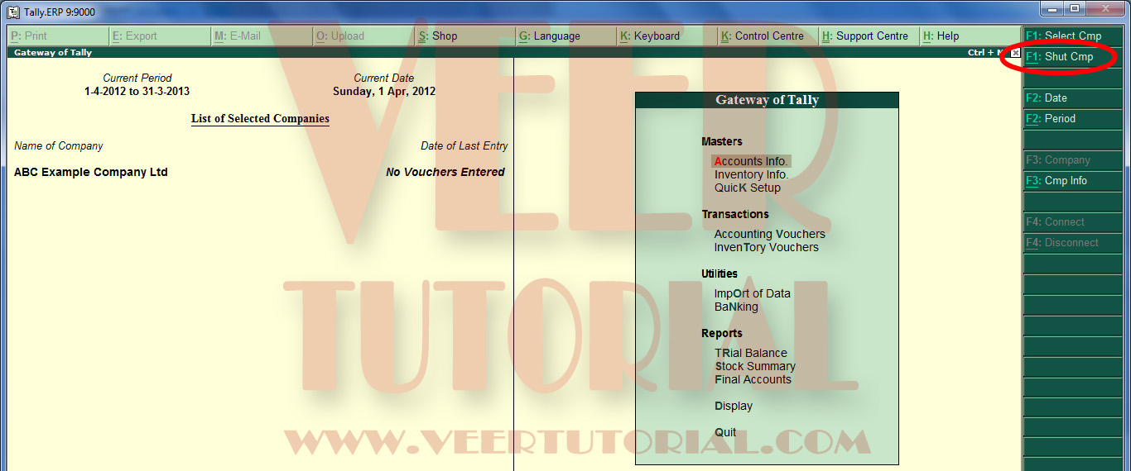
How to Close A Company

Slide 16
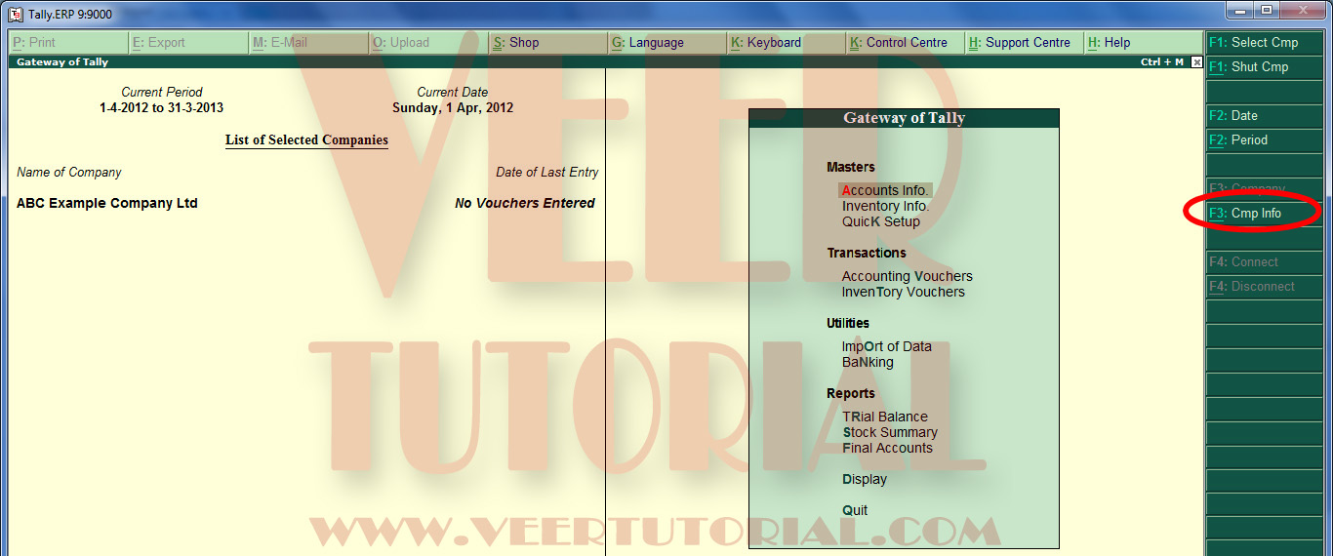
How to Alter Company's Basic Information
For Alter Company's Information Press Alt+F3 or Click on F3:Cmp Info from Right Side Button Panel

Slide 17
Contd….
Company info screen will appear. Select Alter and press enter. Select the company from the list and press enter
Company Alteration screen will appear as shown below:

Slide 18
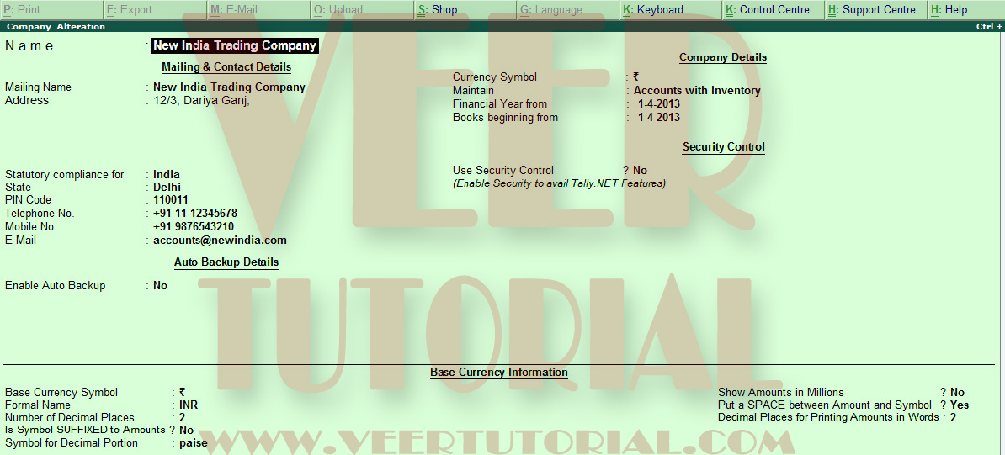
Contd..

Slide 19
How to Delete A Company Permanently
For Delete Company Permanently follow the same procedure upto Company Alteration Screen then press Alt+D
Delete message will popup. Press enter for deletion, Again warning message will pop-up. Press enter if you want to delete otherwise press 'N' or click on 'No' for cancel the deletion

Slide 20
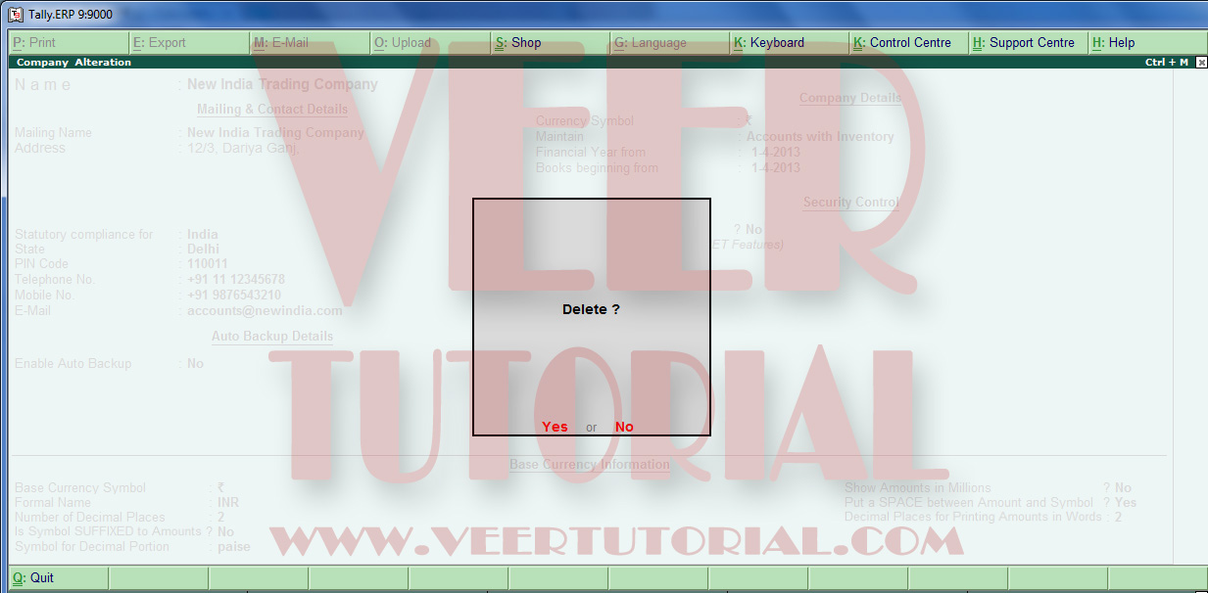
Contd…

Slide 21
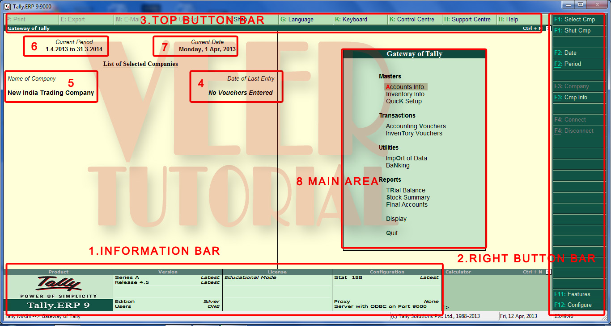
Interface of Gateway of Tally

Slide 22
Explaination
1. Information Bar You will get basic information about Tally Version, Stat File Version and your subscription Id and validity as well. Right side of this bar is Calculator Bar. Press Ctrl + N for use the Calculator
2. Right Side Button Bar You will find all button for voucher entry, configuration buttons etc.
3. Top Button Bar You will find button for Print, Export, E-mail, Upload, Shop, Language, Keyboard, Control Panel, Support Center, Help etc. I will explain all the button in the later chapters
4. Date of last Entry You can see the date of last voucher entry

Slide 23
Contd….
5. Name of the Company You can see the company(s) name here. If you have open more than one company, selected company will be top and in bold form.
6. Current Period You can see the Current Working Period here. You can change this period by press Alt + F2 and enter the date range in the from & to field
7. Current Date As its name suggest, you can see the Present Date (Today's Date)
8. Main Area Its very import place in the tally because you can reach all voucher entries and reports from here

